Slide 1
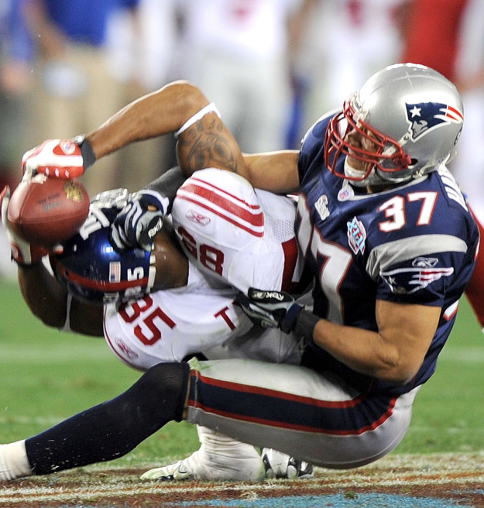
Analysis of Draft Value & Predictors of Success in the NFL Draft​
David Barer, Karam Chadha, Bradley Feingerts, Patrick Holbrook, Chris Payne, Fernando Serrano

Slide 2
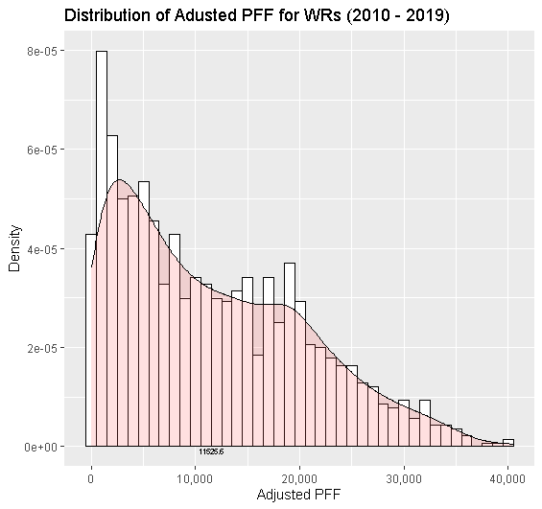
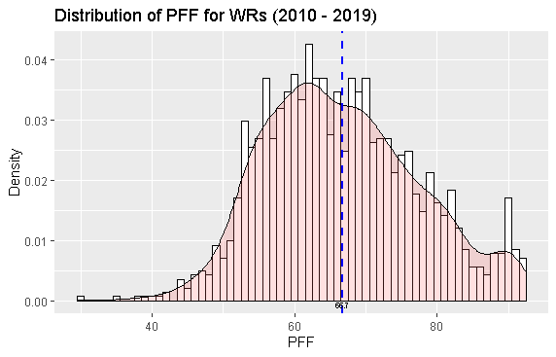
PFF is normally distributed, thus can reveal disparity in talent

Slide 3
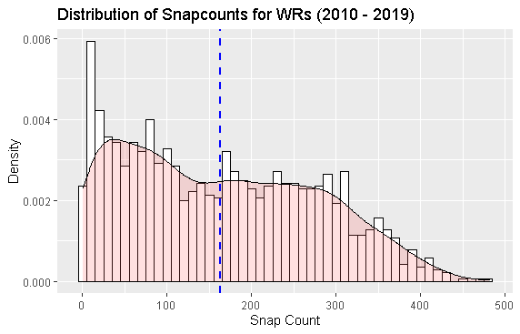
Remove Snap counts below 10?

Slide 4
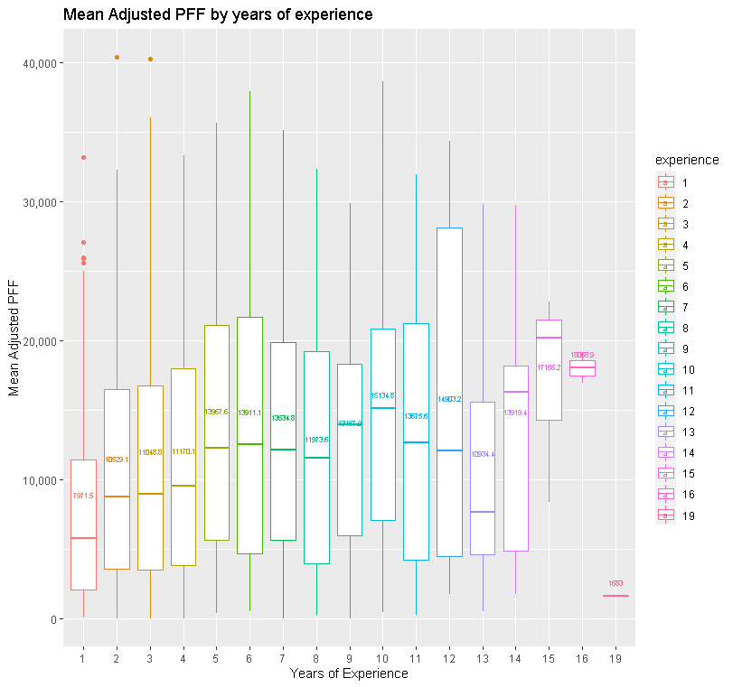
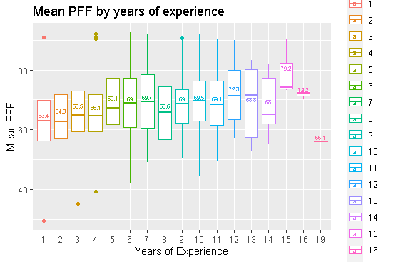
PFF increases by experience, indicating only better players survive

Slide 5
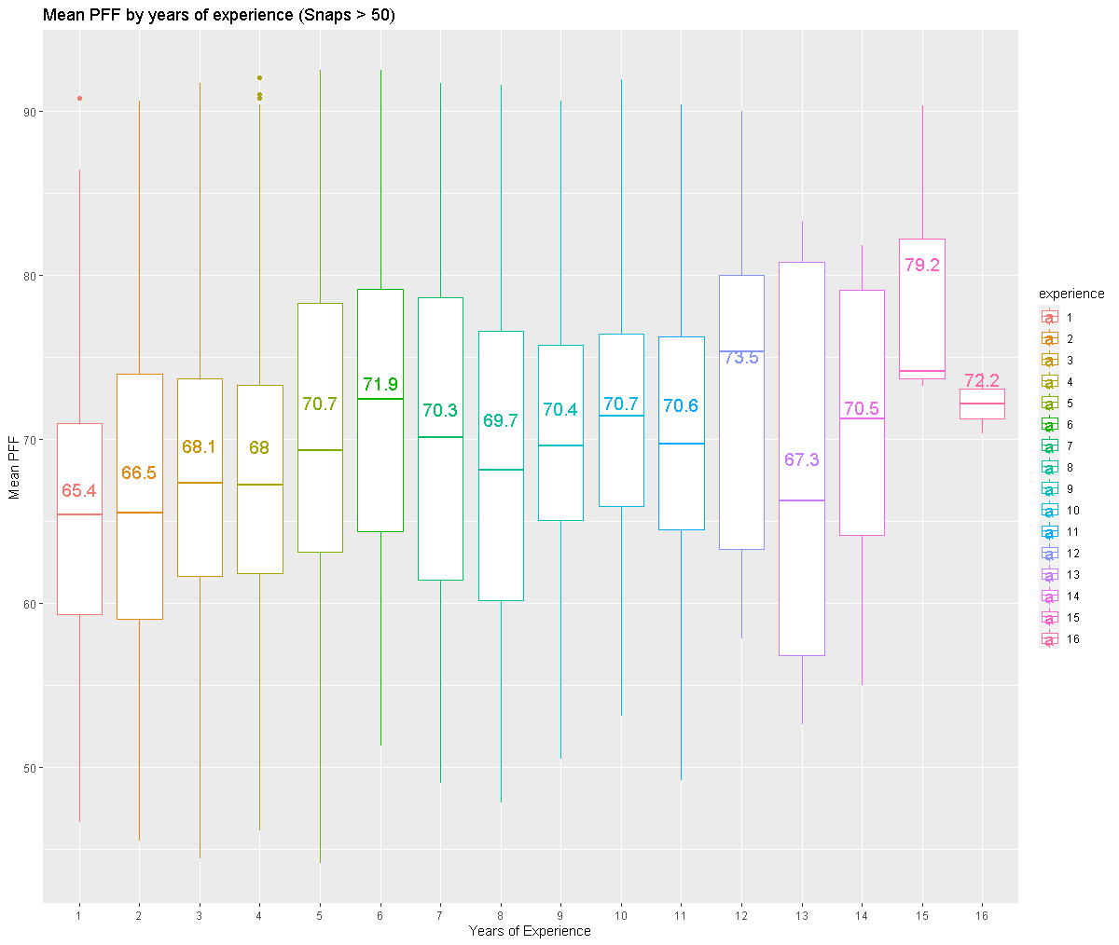
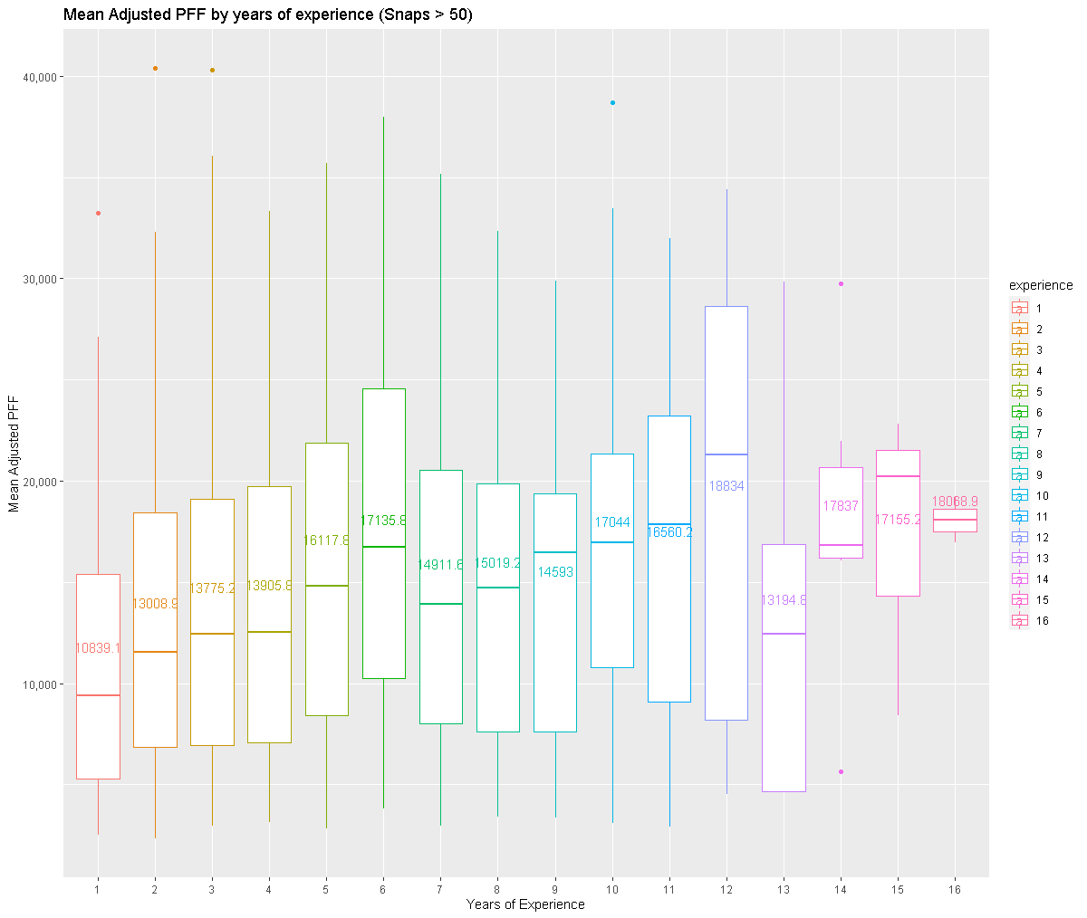
PFF increases by experience, indicating only better players survive (>50 snaps)

Slide 6
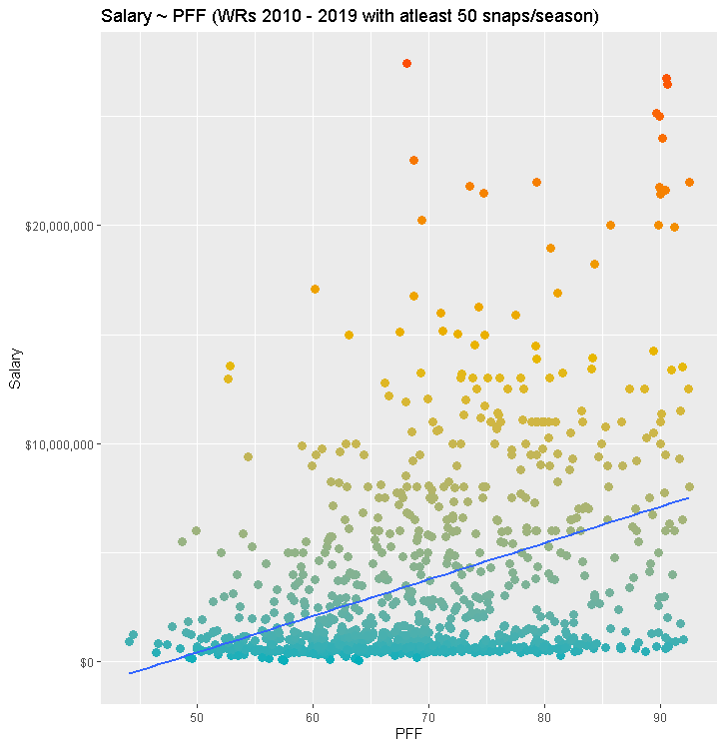
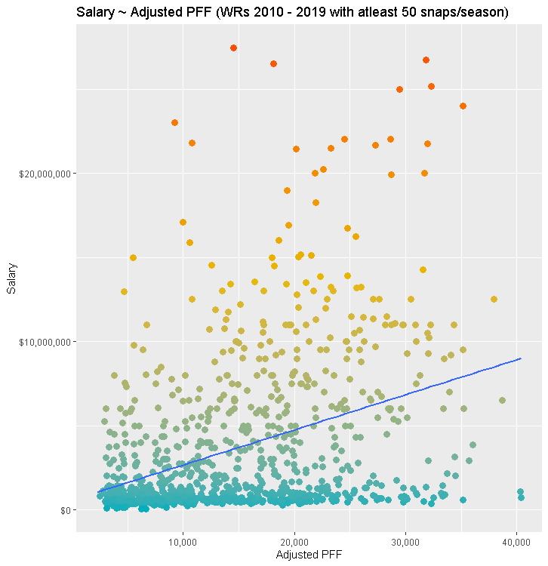
PFF is correlated positively with Salary

Slide 7
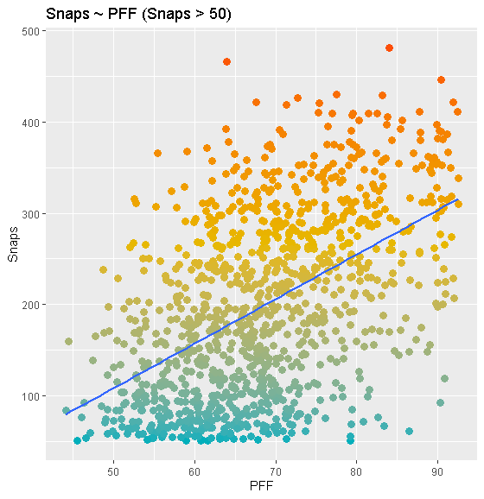
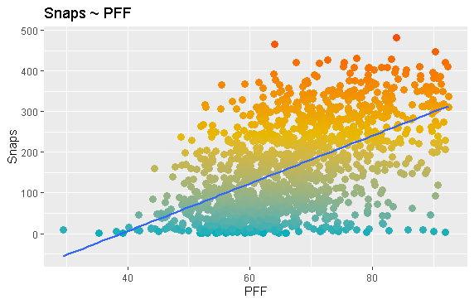
PFF is correlated positively with Snaps

Slide 8
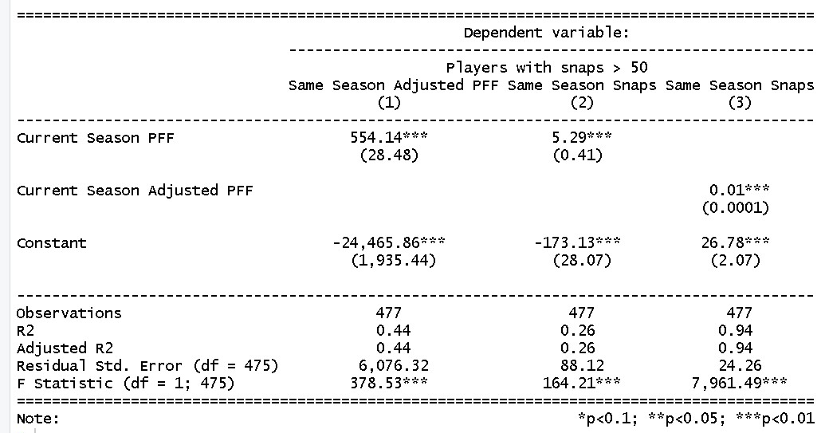
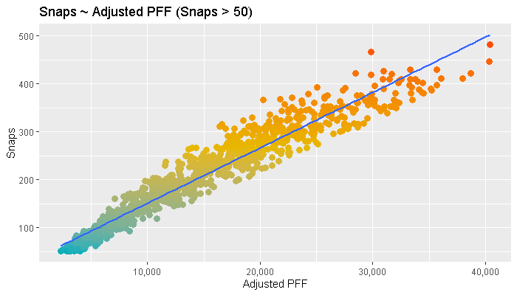
Snaps are very important association of Adjusted PFF

Slide 9

PFF does not correlate with snaps as well as receptions other usage metrics do (opportunity)

Slide 10
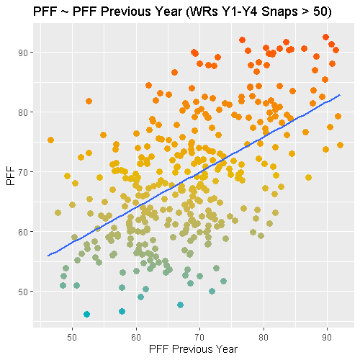
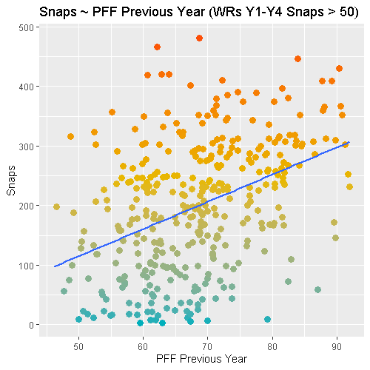
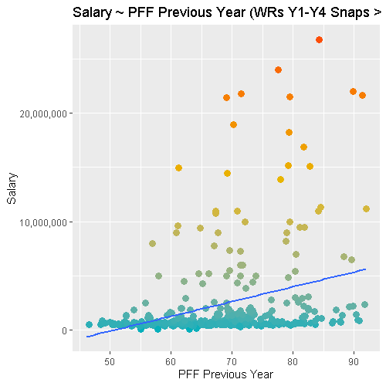
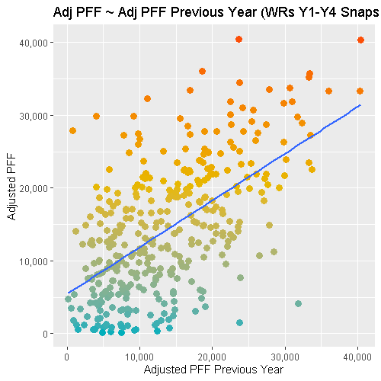
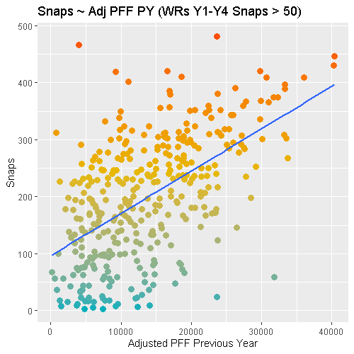
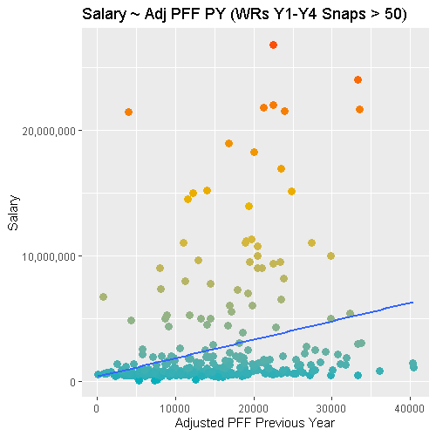

PFF can predict next season Measures, but not salary

Slide 11
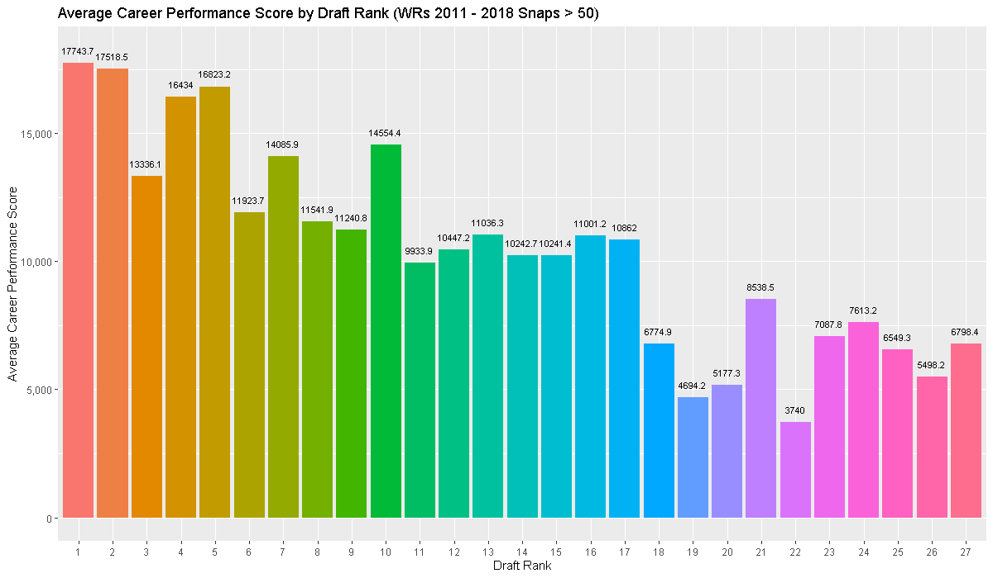
TBD: Career Performance Score by Draft Rank
Career Score = Yds + TD *19.3 → SUMPRODUCT(PFF*Snaps)/Years of Experience

Slide 12
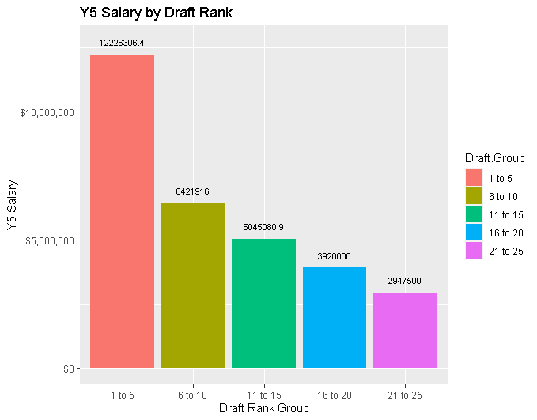
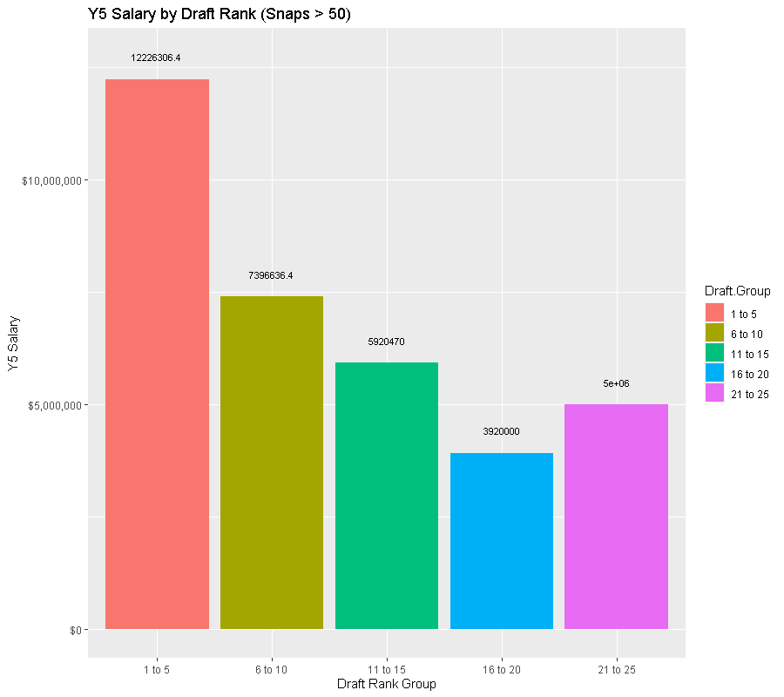
GMs know what they are doing?

Slide 13
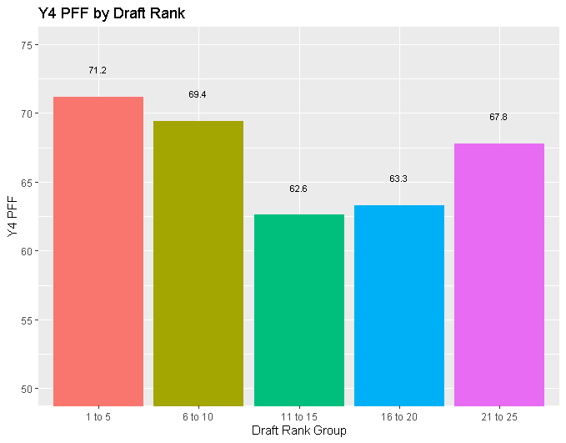
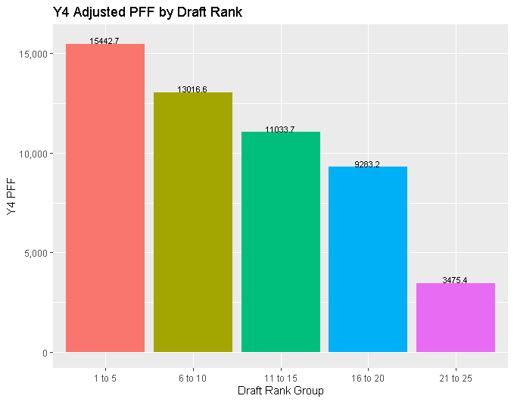
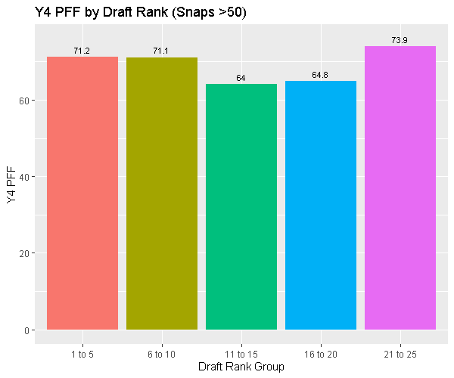
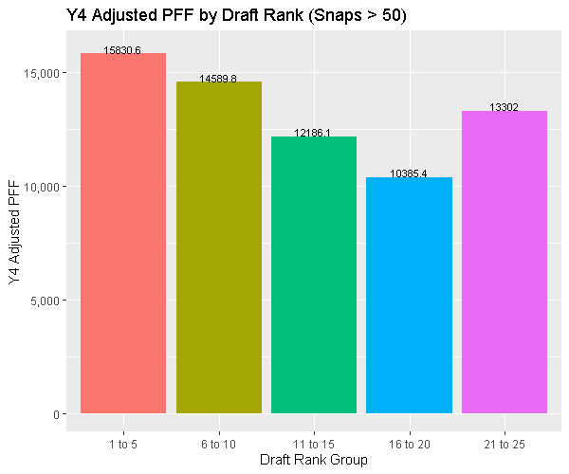
PFF by Draft Rank

Slide 14

Regressing Salary Within Season PFF and Performance

Slide 15
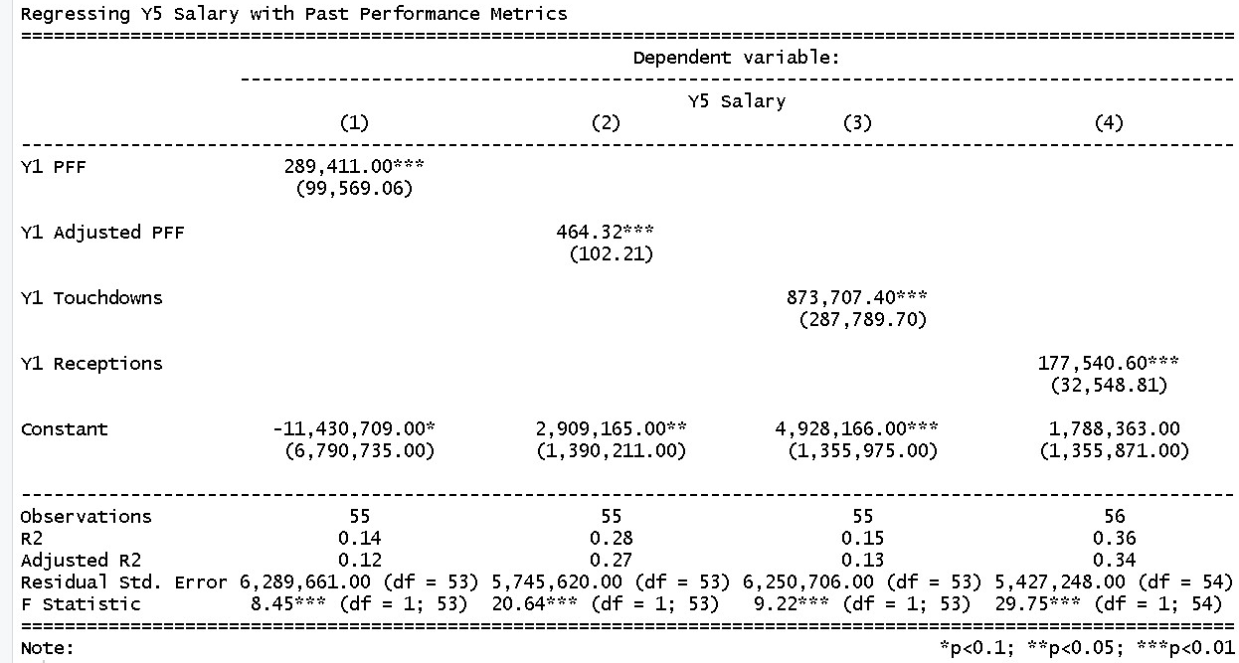
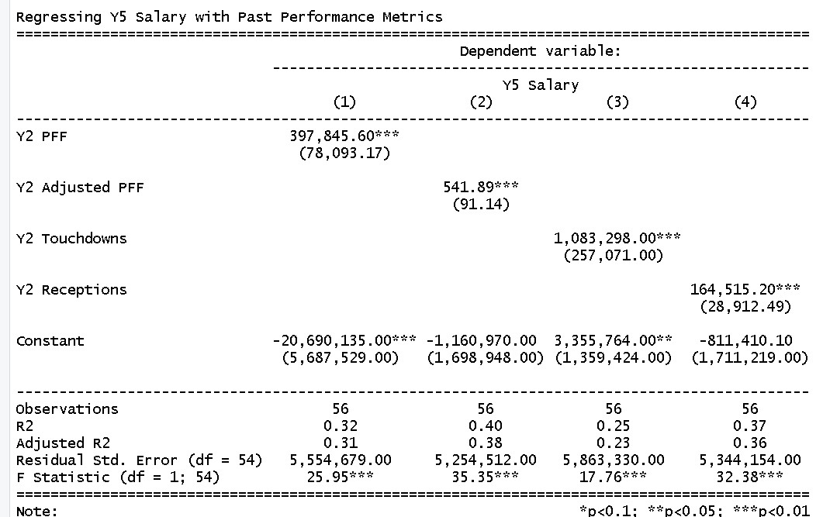
Receptions is a better predictor in year 1, implying usage is important for rookies

Slide 16
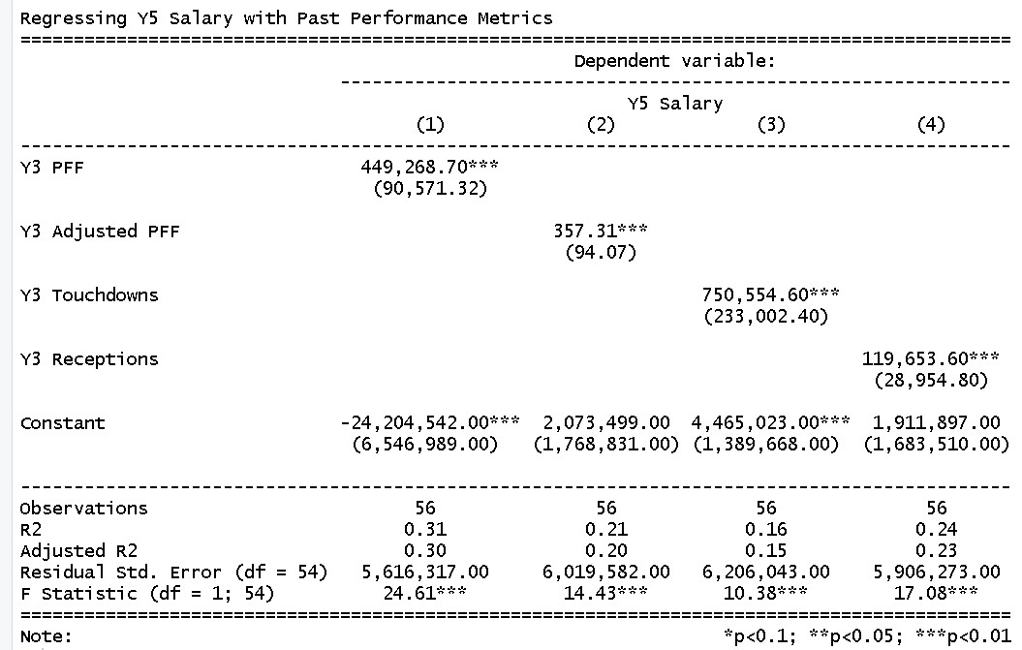
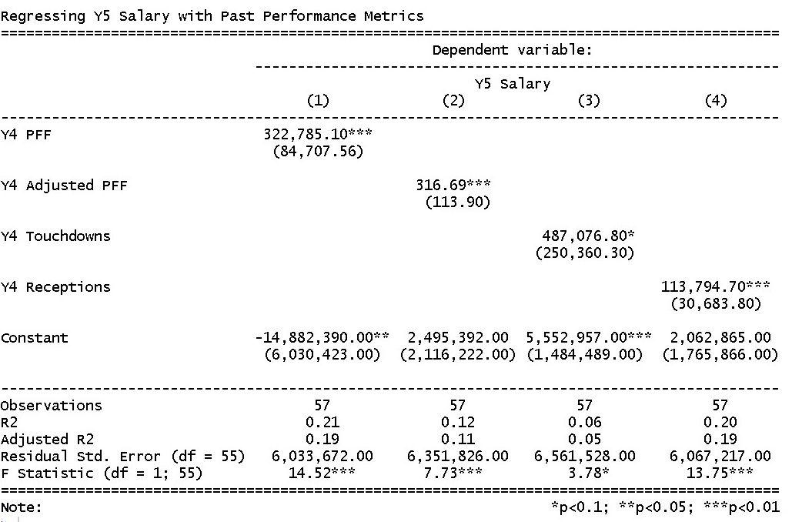
However by Y3 PFF is better at predicting Y5 Comp

Slide 17
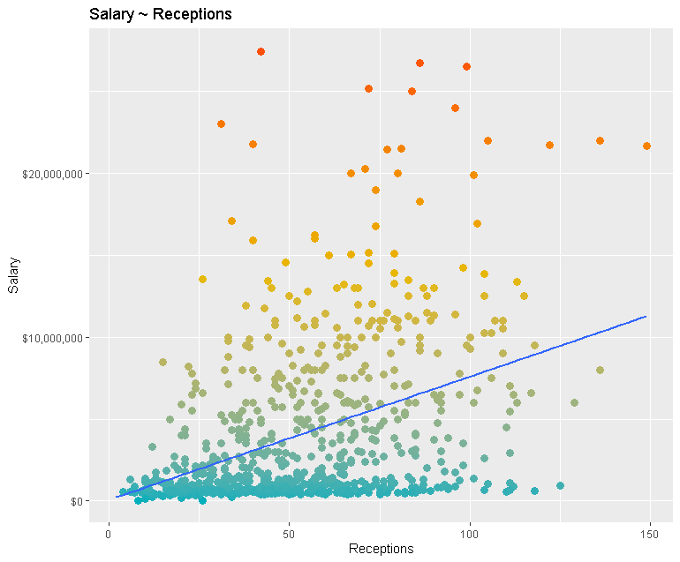
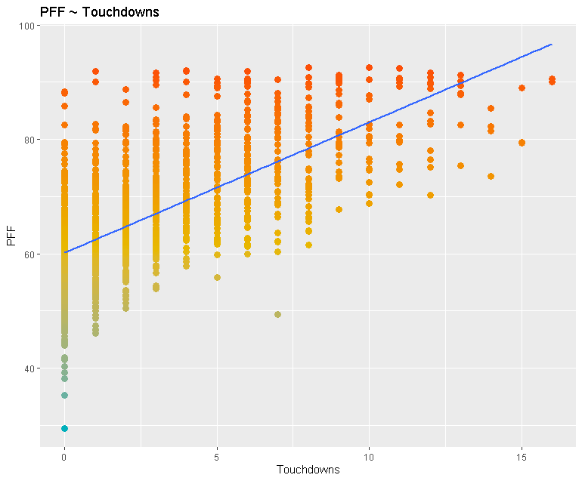
Other Scatter Plots

